Slide 1
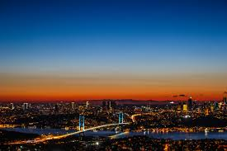
ISTANBUL
“Let’s meet where the continents meet”

Slide 2
LOCATION of ISTANBUL
Istanbul, which is located in the northwest of Turkey, along the Sea of Marmara the Bosphorus and the Golden Horn, is not the capital of Turkey,but the most crowded and important city in Turkey.
It has been the capital for many years to three major Empires
Istanbul is a transcontinental city, its part in Europe is called the European Side or Rumeli Side, and its part in Asia is called the Anatolian Side or the Asian Side.

Slide 3
Climate
Three climates can be seen in Turkey and also in Istanbul.
On the Black sea coast:
Summers are cool
Winters are warm.
The Inner parts:
Summers are hot
Winters are cold.
On the Meditearranean Coast:
Summers are hot and dry
Winters are warm and rainy.

Slide 4
Some of the Tourist Attractions in Istanbul

Slide 5
The blue mosque
is known as Sultan Ahmed Mosque, was built by the Ottoman Sultan Ahmed I between 1609-1617. It took its name from the blue tiles inside.It is in the European side of Istanbul.

Slide 6
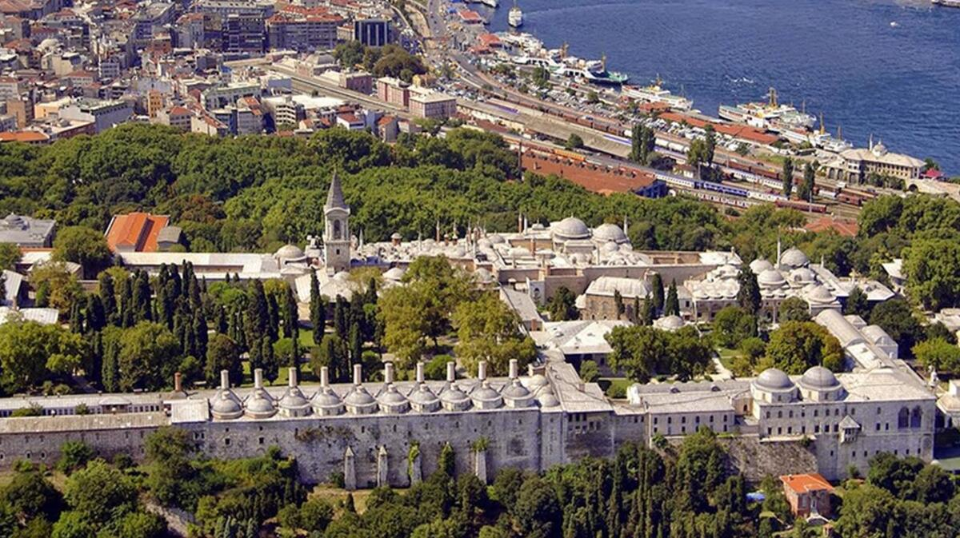
Topkapı palace
was an Ottoman Palace which was built by Mehmet the Conquerer. He conquered Istanbul in 1453.
And in 1924 it became one of the most significant museums in Istanbul.

Slide 7
Basilica Cistern
Located on the same historical peninsula with the Hagia Sophia and the Blue Mosque.
This subterranean structure was commissioned by Emperor Justinian and built in 532. The largest surviving Byzantine cistern in İstanbul, it was constructed using 336 columns, many of which were salvaged from ruined temples and feature fine carved capitals.
It was originally known as the Basilica Cistern because it lay underneath the Stoa Basilica, one of the great squares on the first hill.
This cistern is an underground chamber approximately 138 meters by 65 meters. It covers an area of 9,800 square meters, capable of holding almost 80,000 cubic meters of water.
The cistern met the water needs of the Byzantine palaces and other residents in the area was used for a while after the conquest of Istanbul in 1453. The water was used in the gardens of Topkapı Palace.

Slide 8
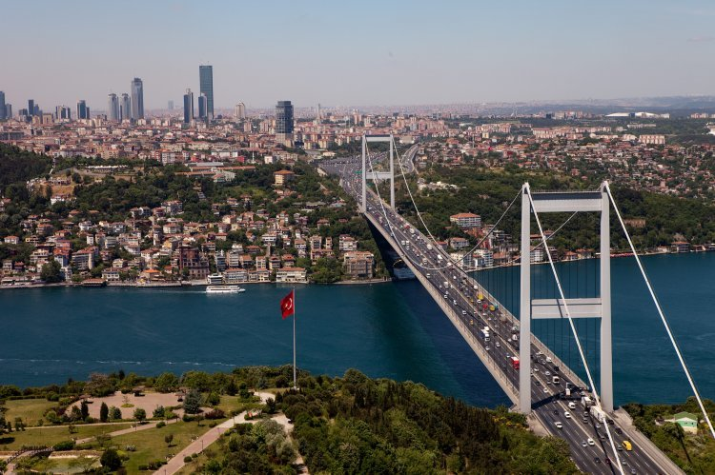
The Bosphorous
is the strait that combines European and Asian Continents. It ‘s 29,9km long.
The residential area, spread on both sides, is also called The Bosphorous.

Slide 9
Beylerbeyi Palace
was built in 1865 in Uskudar. Its architectural style is Ottoman Style.

Slide 10
Dolmabahçe palace
was an Ottoman Palace, built in 1850, located in Beşiktaş, Bosphorus. Its view is very beautiful.
It’s also the Palace where our immortal leader Atatürk passed away.

Slide 11
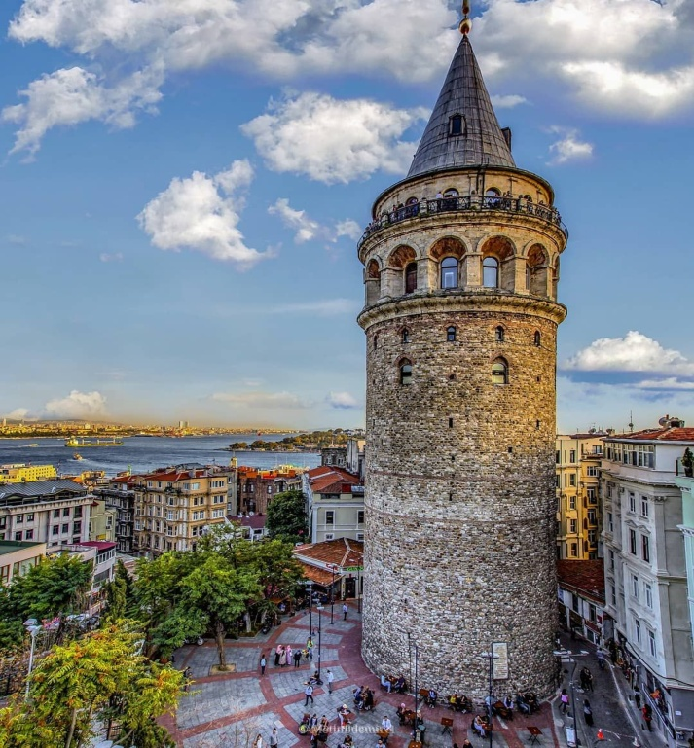
GALATA TOWER
-The construction date of the tower is not certain. There are myths about it. It’s estimated that the tower was built at 500 AD
-It’s in the middle of the Taksim square.
-You can climb up to tower and enjoy the view.
There is a rumor about Maiden’s Tower and Galata tower.
Rumor is that Maiden’s Tower and Galata Tower are in love with each other.
However they can not come together because of Bosphorus.

Slide 12
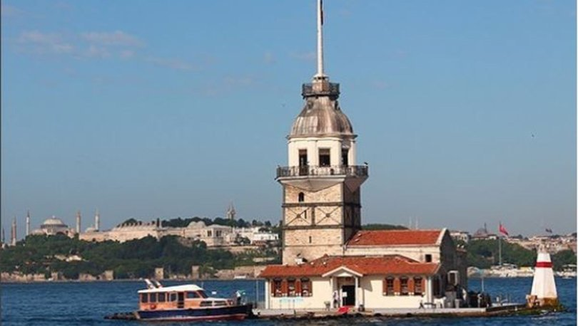
Maıden’s tower
-In the middle of the Bosphorus.
-Dating back to 2500 years.
-Why the tower was built for is unknown.
-Roman and Byzantine used this to block the enterance of enemy boats.
-During the Ottoman Empire, the tower was used as a manifestation more than a defense tower.
The name comes from a legend: the Byzantine emperor heard a prophecy telling him that his beloved daughter would die at the age of 18 by a snake. So he decided to put her in this tower built on a rock on the Bosphorus isolated from the land thus no snake could kill her.

Slide 13
Sümela Monastary
It’s on the UNESCO World Cultural Heritage List. It’s located in Black Sea Region in the Northeast of Turkey. It was built by carving the rocks. It was built on the name of Virgin Mary by Byzantines.

Slide 14
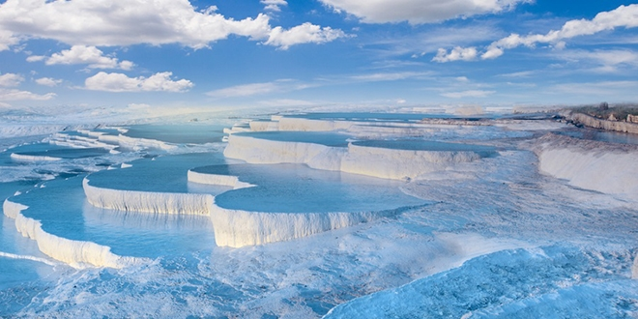
Pamukkale travertınes
These travertines looks like snow and cold. But they are not cold. People can get into the travertines. The white part of travertines are stone but its a different stone. Its name is Limetone.
And blue parts of travertines are water. People can use this water for drink or bath. This water have minerals for example carbonate mineral.

Slide 15
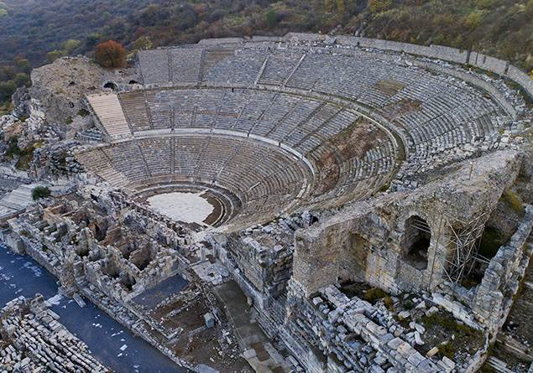
Ephesus ancıent cıty
Ephesus Ancient City is very huge museum. Romans built in 1050 Bc. Also there is a huge theater area. Your voice can reach without microphone.Because there is an echo system .

Slide 16
Cappadocia
There are natural rock formations called “Fairy Chimneys”.
It’s a touristic place.
It has stone-built hotels and historic churches. Hot air balloon rides are the most popular activity.

Slide 17
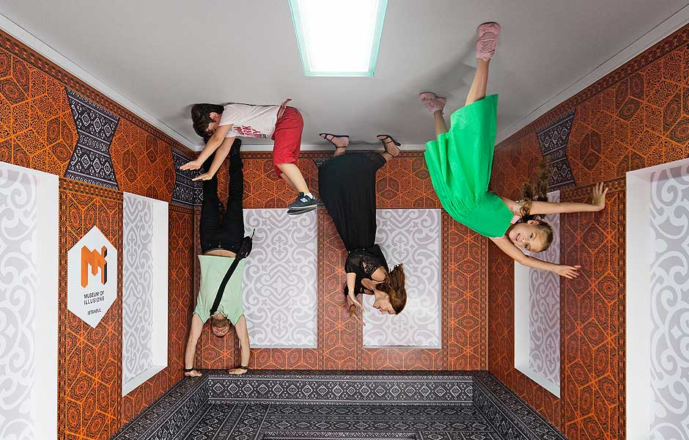
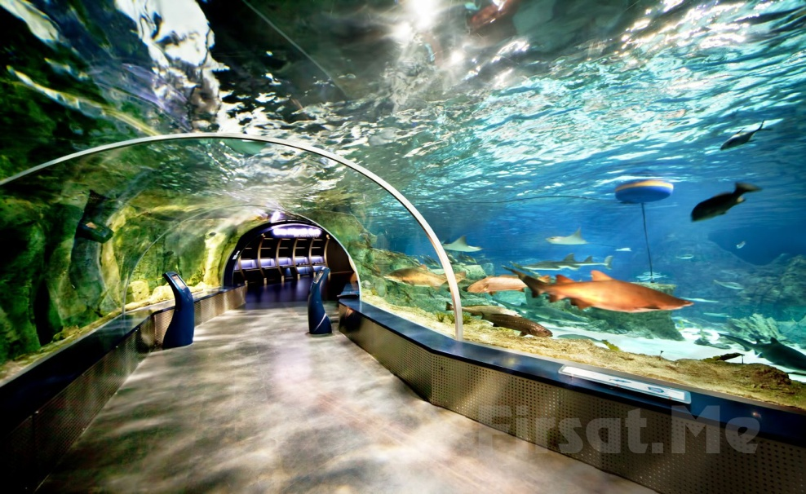
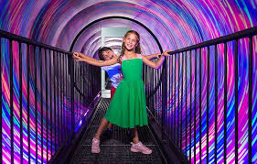
Recreational Activities
1- Amusement Parks
Amusement Parks in İstanbul: Vialand, Feshane Chıldren’s Entertaınment Park, Moipark, etc…
Amusement Parks usually have gondolas, huge ferris wheels, roller coasters etc…
2 - Aquarium and Underwater Zoo
Sea Life Aquarium, Istanbul Aquarium, Emaar Aquarium
Dolphinarium Dolphin Show Center

Slide 18
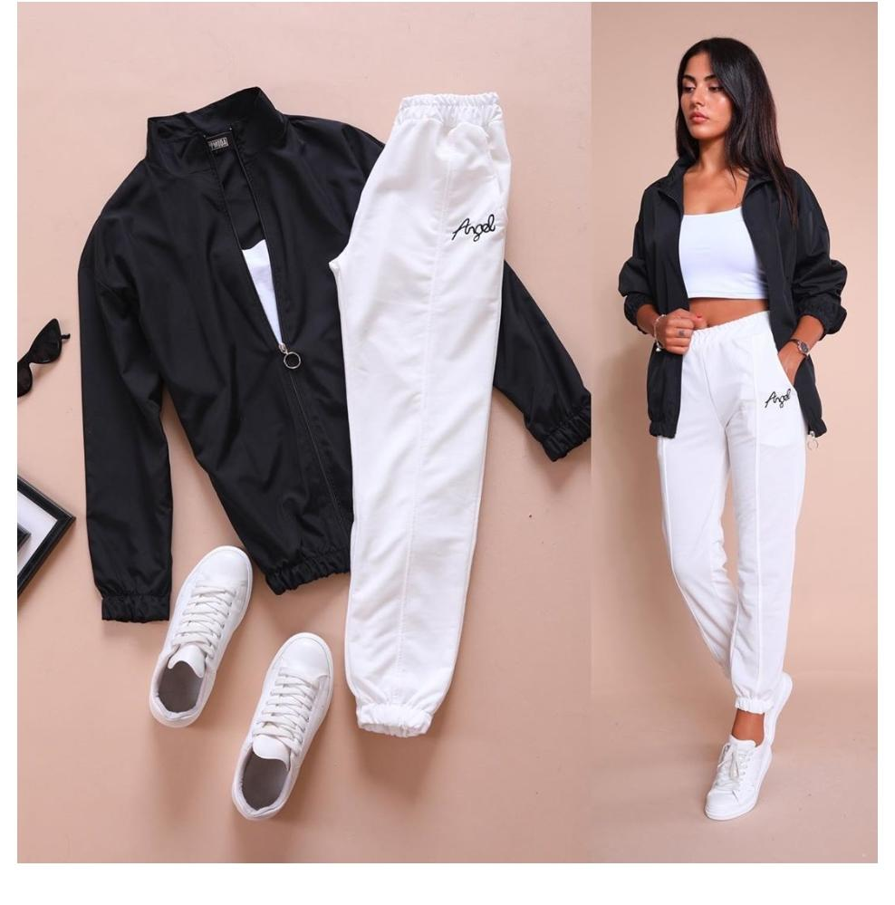
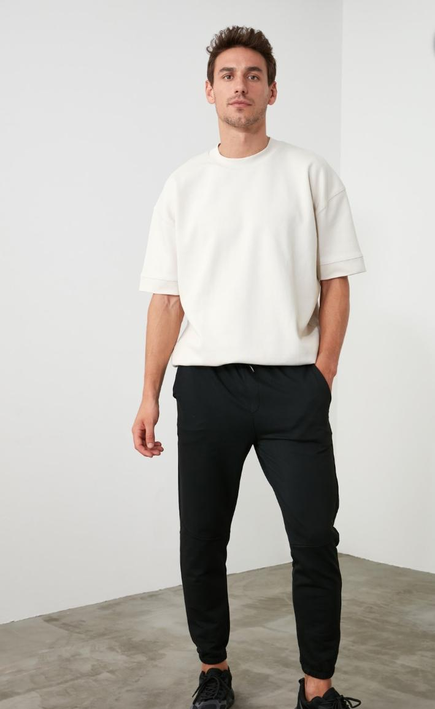
Clothes
Teenagers mostly wear casual clothes in Istanbul

Slide 19
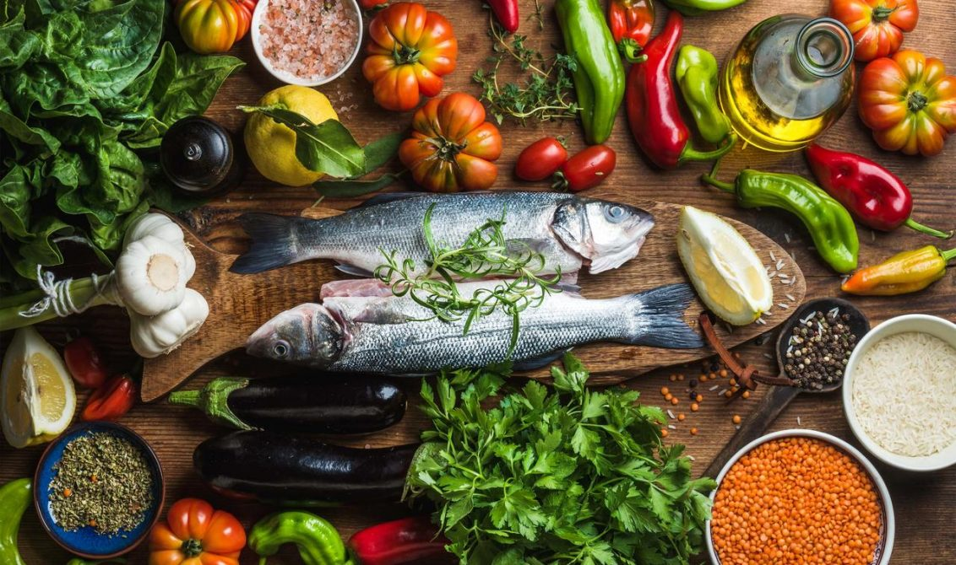
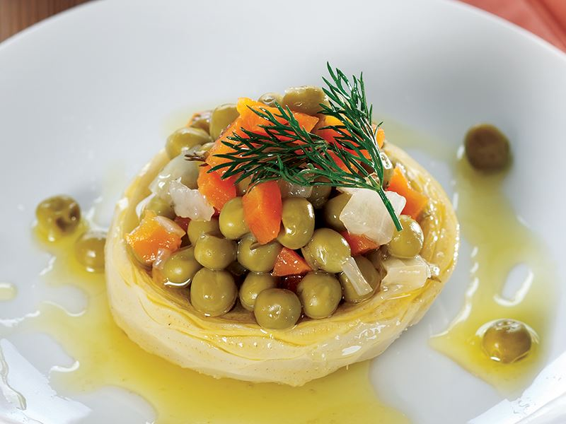
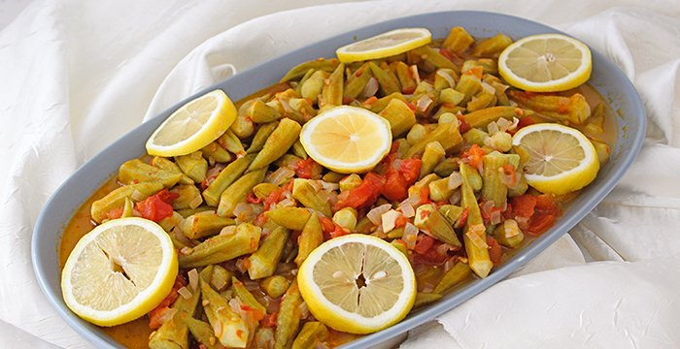
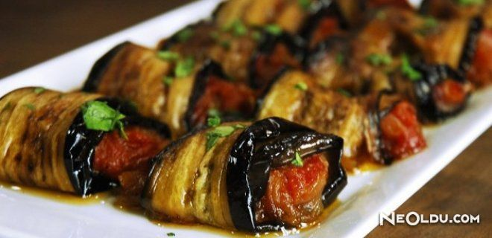
medıterranean Cuisine
includes olive oiled healthy flavors as well as delicious, contains foods rich in vitamins and minerals.

Slide 20
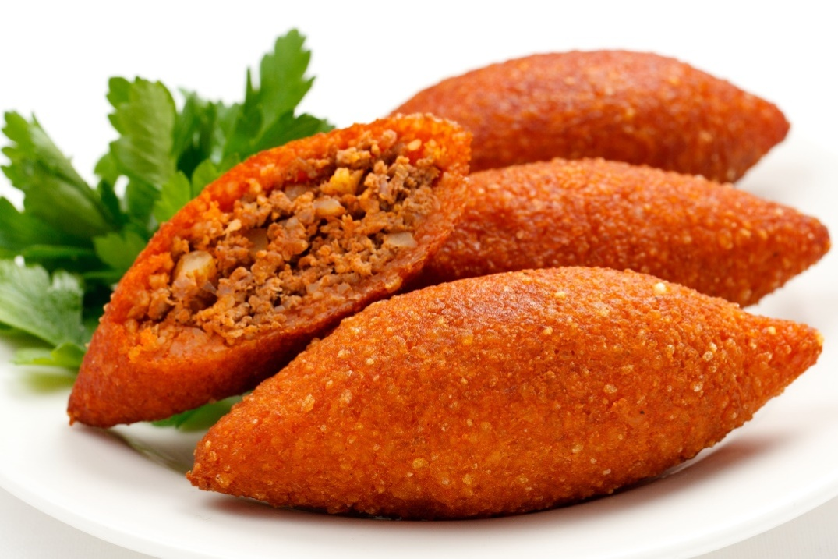
Eastern Anatolian Cuisine
attracts attention especially with its meat dishes and desserts.
Spices and herbs are widely used in the kitchen.

